Slide 1
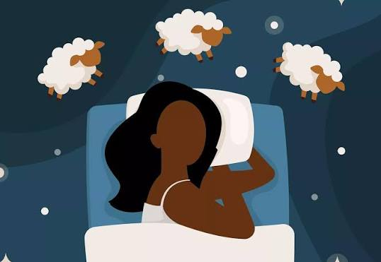
The importance of sleep
Rest well think better. Live healthier

Slide 2
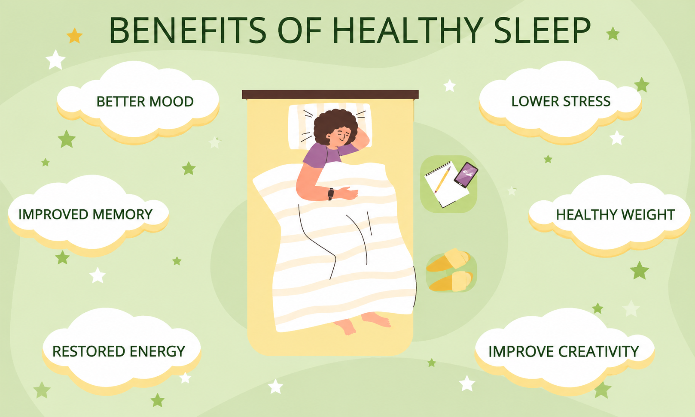
Why sleep Matters
Restores energy and supports physical growth and repair.
Helps the brain process information and strengthen memory.
Supports attention, concentration and learning.
Helps regulate mood and emotional well-being.
Good sleep supports the immune system and overall healthy.

Slide 3
How much sleep you need
Age group | Recommended sleep | Why it matters
6 - 12 years | 9 - 12 hours | Growth & learning
13 - 18 years | 8 - 10 hours | Brain & body health
18 - 60 years | 7+ hours | Health & recovery

Slide 4
What happen when we don’t sleep enough
Short Term Effects
Long Term Effects
Brain slowdown: You face trouble focusing, remembering things, and making clear choices.
Mood swings: You feel more angry, sad, or cranky.
Slow reactions: Your response time drops, raising the risk of accidents.
Low energy: You feel tired and weak all day.
Weak immune system: Your body struggles to fight off common germs like colds.
Weight gain: Bad sleep changes hunger hormones, making you crave junk food.
Heart strain: Your blood pressure rises, increasing heart disease risks.
Higher disease odds: Chronic sleep loss links to type 2 diabetes and long-term mental health struggles.

Slide 5
Simple habits for better sleep
Daily Schedule
Wake up at the same time every day, even on weekends.
Get sunlight in the morning for at least 30 minutes to set your body clock.
Limit naps to 20 or 30 minutes in the early afternoon.
Evening Routine
Turn off screens like phones and TVs one hour before bed.
Wind down with a book, soft music, or deep breathing.
Write down any worries or next-day tasks to clear your mind.
Diet and Activity
Avoid caffeine and heavy meals late in the day.
Skip alcohol close to bedtime, as it wakes you up later.
Exercise early, but finish workouts at least two to three hours before sleep.
Sleep Environment
Keep the room dark using heavy curtains or an eye mask.
Keep it cool, around 60°F to 67°F (15°C to 19°C).
Use the bed only for sleeping.
Sleep - Wikipedia

Slide 6
Thank you..

